Slide 1
SECURE DATA HIDING IN IMAGE USING STEGANOGRAPHY
CAPSTONE PROJECT
Presented By:Komal Jadhav
Student Name : Komal Jadhav
College Name & Department : Secab institute of technology and engineering college vijaypure 586109
department:computer science

Slide 2
OUTLINE
Problem Statement
Technology used
End users
Result
Conclusion
Git-hub Link
Future scope

Slide 3
Problem Statement
With the rapid advancement in digital communication, ensuring the privacy and security of sensitive information has become a critical concern. Traditional encryption methods, while effective in protecting data during transmission, often attract suspicion due to their detectable nature. An alternative approach to secure data transmission is the use of steganography

Slide 4
Technology used
Python(using the library opencv)
c/c++
java
platform= operating system

Slide 5
End users
Government and Intelligence Agencies
Governments and intelligence agencies use steganography for covert communication, ensuring that sensitive information can be hidden within ordinary images and transmitted without drawing attention.
Cybersecurity Professionals
Cybersecurity experts often use steganography to test the resilience of systems against hidden data attacks and to defend against malicious steganography techniques used by cybercriminals.
Military Personnel
Military operatives, especially those working in sensitive or high-risk zones, use steganography to communicate securely without raising suspicion
Journalists and Whistleblowers
Journalists and whistleblowers may use steganography to securely transmit sensitive documents, images, or messages, ensuring their source remains anonymous and safe from persecution.

Slide 6
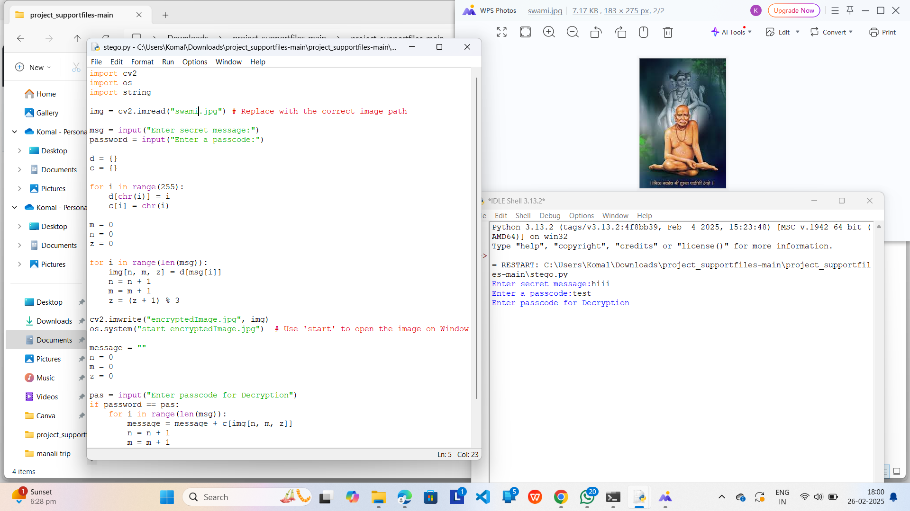
Results

Slide 7
Conclusion
In conclusion, secure data hiding using steganography is a vital tool for ensuring the privacy, confidentiality, and integrity of information in a digital age where data breaches, surveillance, and cyber threats are rampant. Its continued development and integration with other security measures will be essential in maintaining secure, private, and trustworthy communications across various sectors.

Slide 8
GitHub Link
https://github.com/komaljadhav23/AICT-Project.git

Slide 9
Future scope(optional)
Advance Encryption Techniques
support for audio and video steganography
Ai-based detection prevention
Multi-layer security

Slide 10
THANK YOU

